Slide 1
NFL Viewership Dataset Analysis
By Jesse Zamora

Slide 2
Variables
The 6 variables I will be covering are the viewership numbers from 2010,2012,2014,2016, 2018 and 2020
These 6 variables will be used to show the average amount of viewership in each respective year

Slide 3
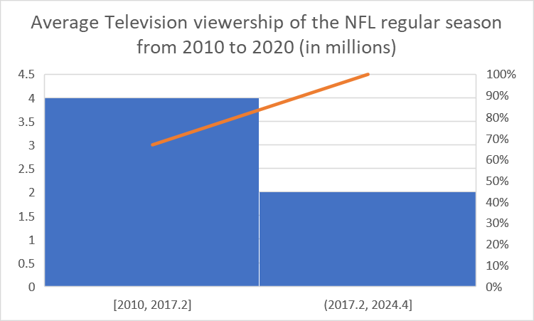
Histogram

Slide 4
Histogram Explained
The histogram does look rather confusing. I tried several different ways and regardless the outcome – I could not get the year to be the title and the viewership totals in the data.
I used the same data set and created pie charts, line graphs and bar graphs and every single one showed the years as the legend and the viewership totals as the data.

Slide 5
Variable scenarios
I would compare years 2010 (17.9 million viewers) and 2020(14.9 million viewers) and try and see where the discrepancy in 3 million viewers comes from.

